Slide 1
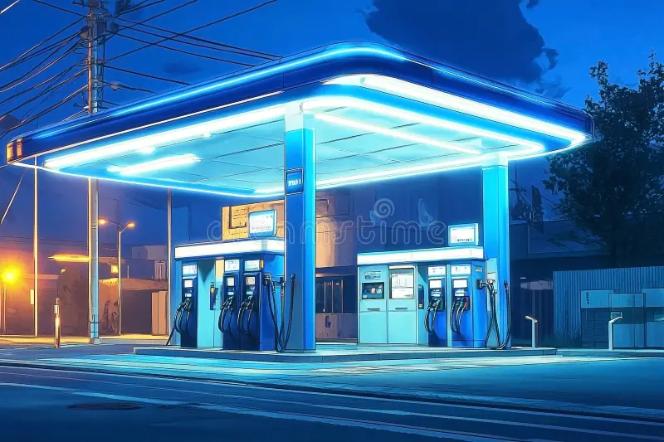
FILLING
STATION MANAGEMENT
MOBILE APPLICATION
GROUP 19

Slide 2
List of team members
ID | Name | Degree Program
10953744 | Aluth Siyara | CS
10953753 | Herath Herath | CS
10953773 | Wijayakoon Ekanayake | CS
10953662 | Kaushalya Ratnasabapathy | CS
10953660 | Lansakara Lansakara | CS
10953705 | Koggala Shakya | CS
Team members

Slide 3
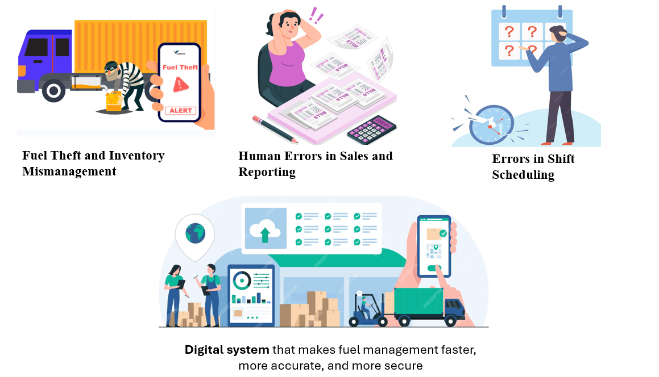
Identified problems and solution with valid justifications
Identified Problems & Solution

Slide 4




Inventory Management
System solution with objectives
SYSTEM OBJECTIVS
& Stake holders
Overall
Management
online ordering system
managing employees

Slide 5

Programming Languages and Frameworks
Flutter (Dart):
Firebase:
Node.js:
Development Tools
Android Studio & Visual Studio Code
Git & GitHub.
Figma
Cloud Services
Firebase FireStore
Firebase Authentication (For login).
architectural development and OOP Concepts
System Architecture

Slide 6
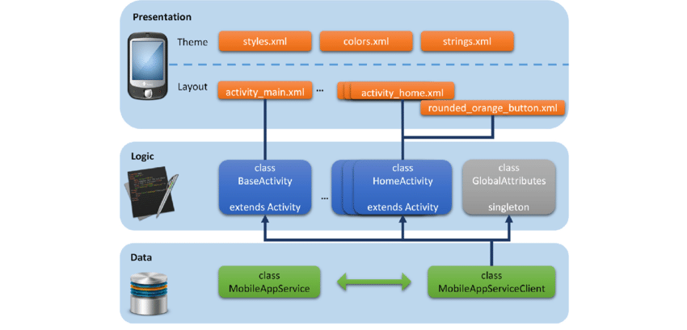
High-level system architecture diagram
diagram of system architecture/high-level
System Architecture

Slide 7
Walk through different features and functionalities
PROJECT Demonstrate
Screen recording or live demo showcasing user interactions

Slide 8
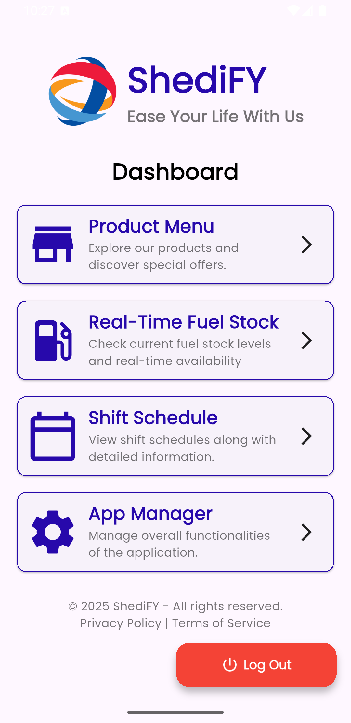
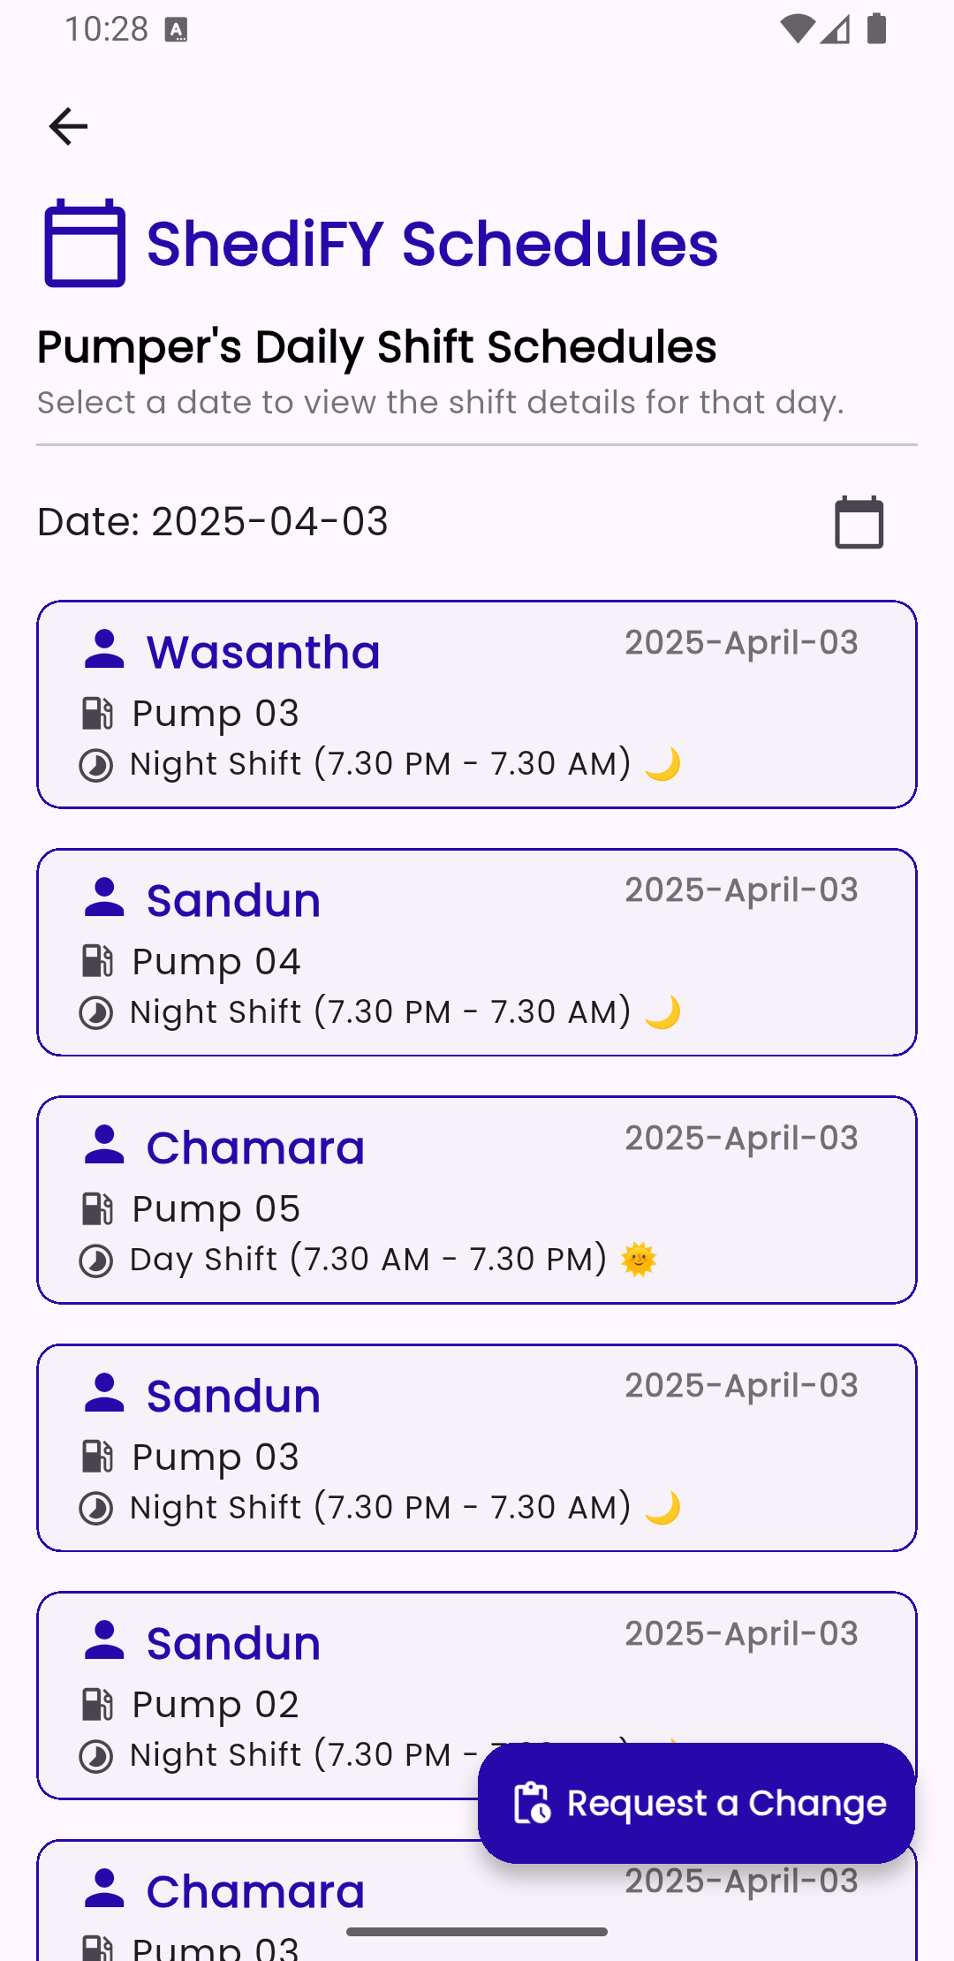
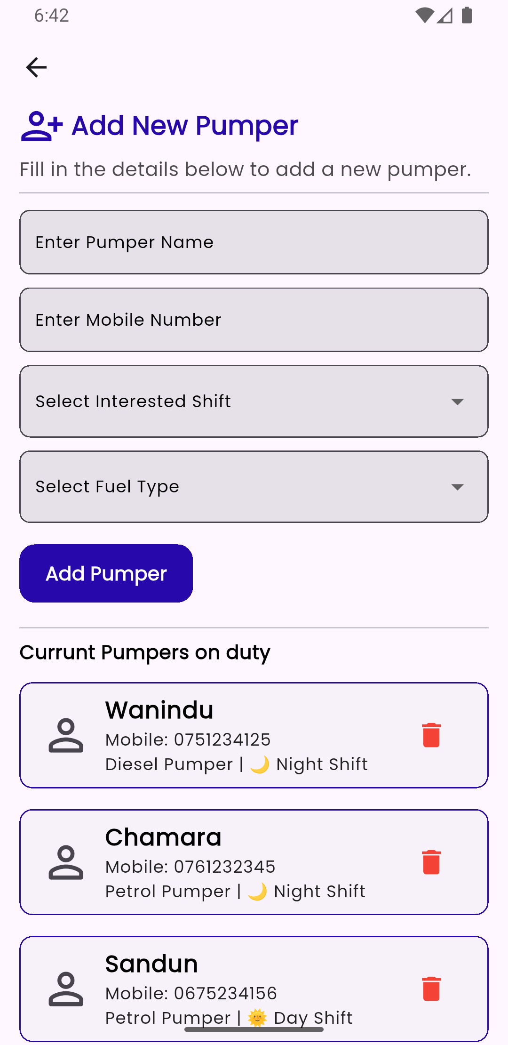

Member - 1
10953753 – Herath Herath
Individual Contribution

Slide 9
Member - 1
10953753 – Herath Herath
Individual Contribution

Slide 10
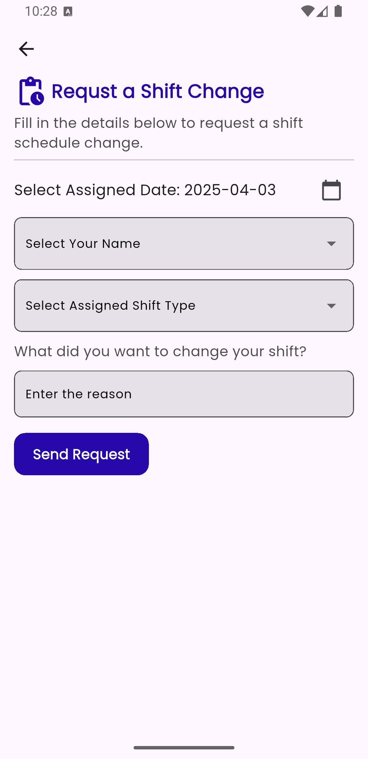
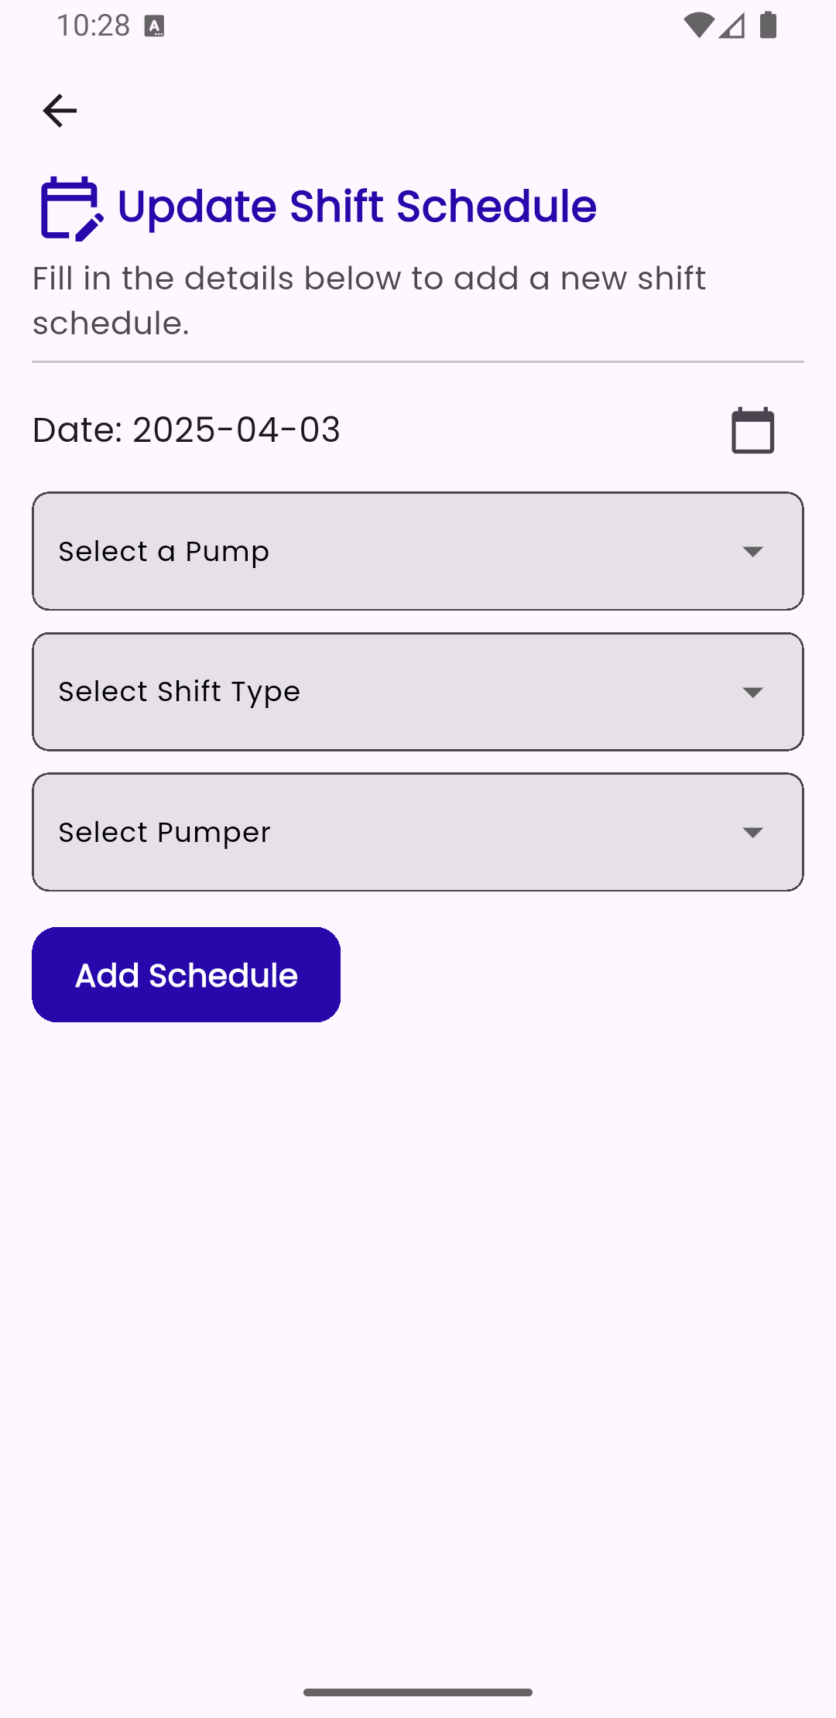
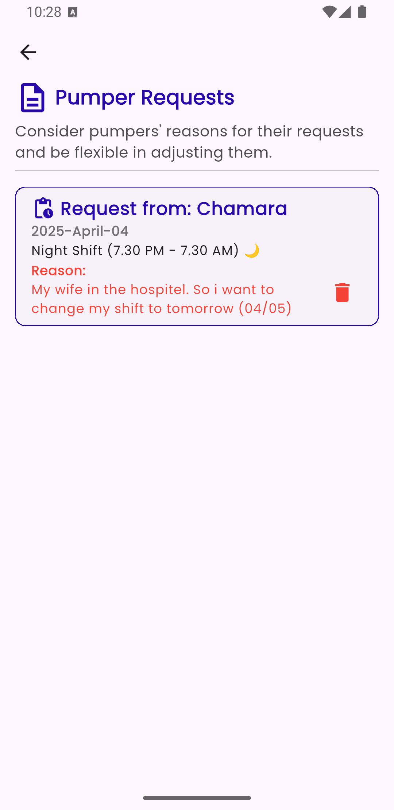
Member - 2
1010953773 - Wijayakoon Ekanayake
Individual Contribution

Slide 11
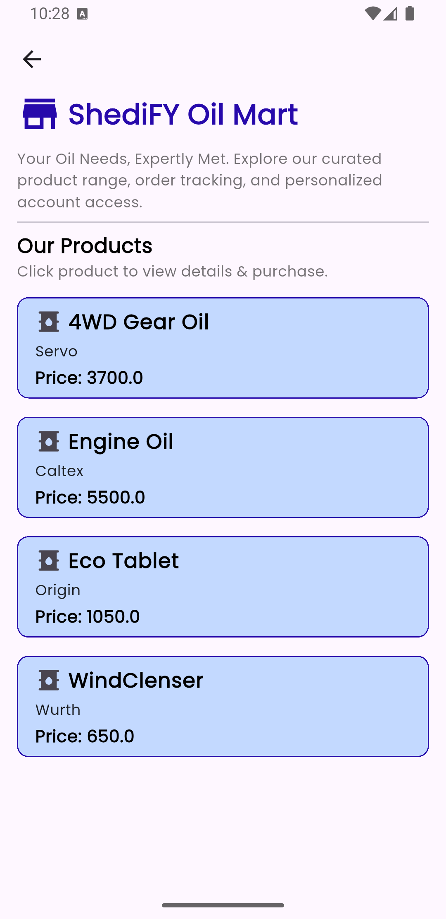
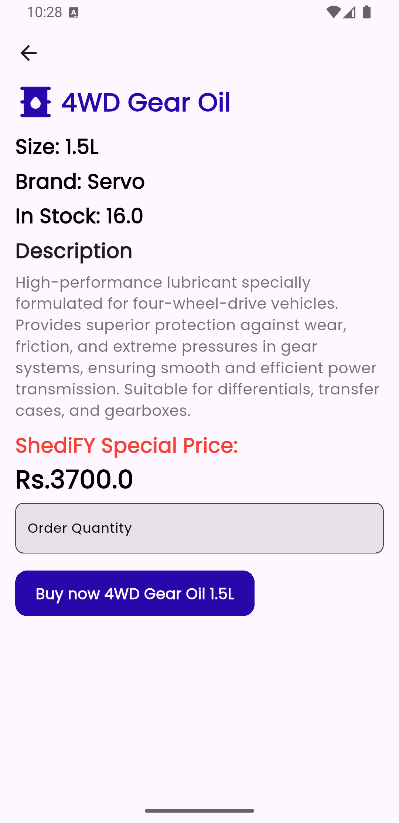


Member - 3
10953744 – Aluth Siyara
Individual Contribution

Slide 12
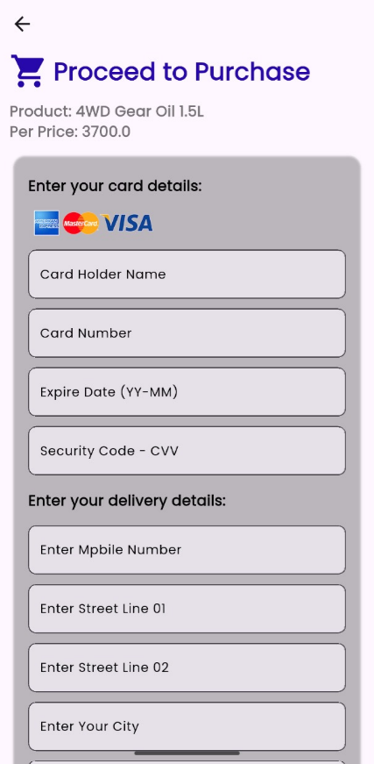
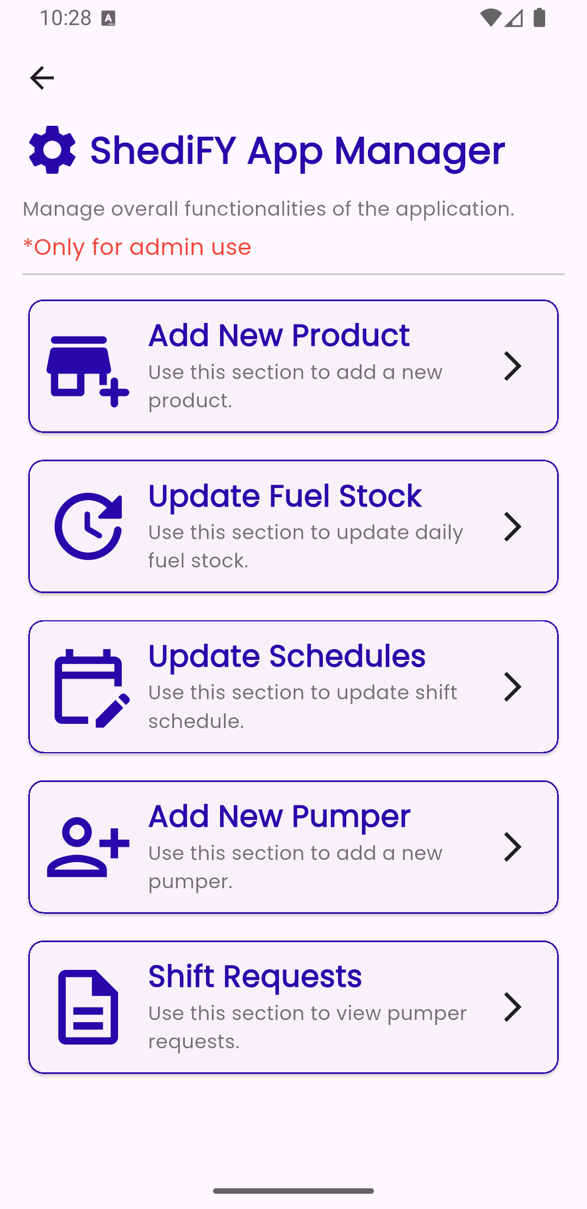
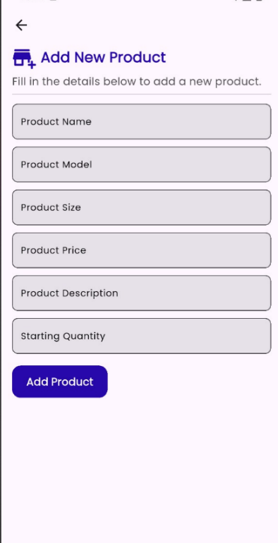
Member - 3
10953744 – Aluth Siyara
Individual Contribution

Slide 13
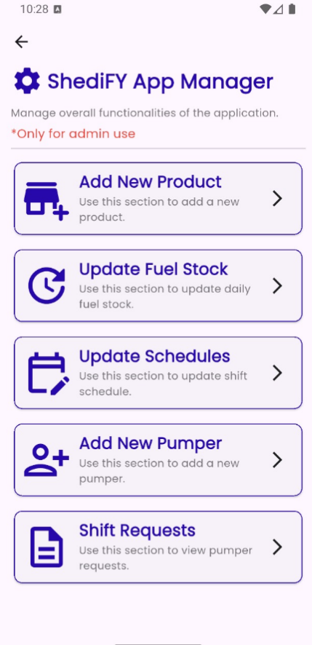
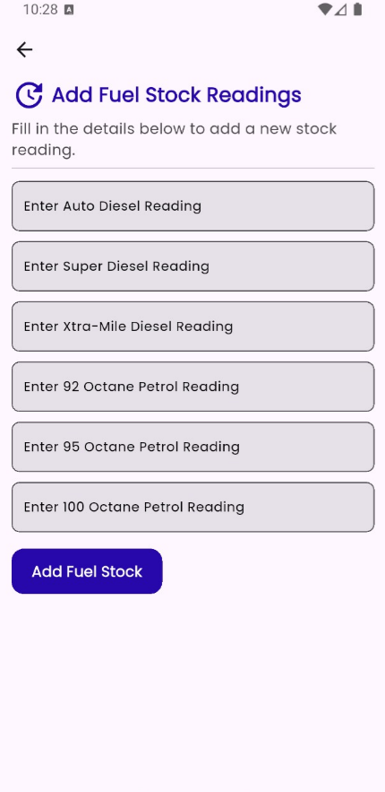
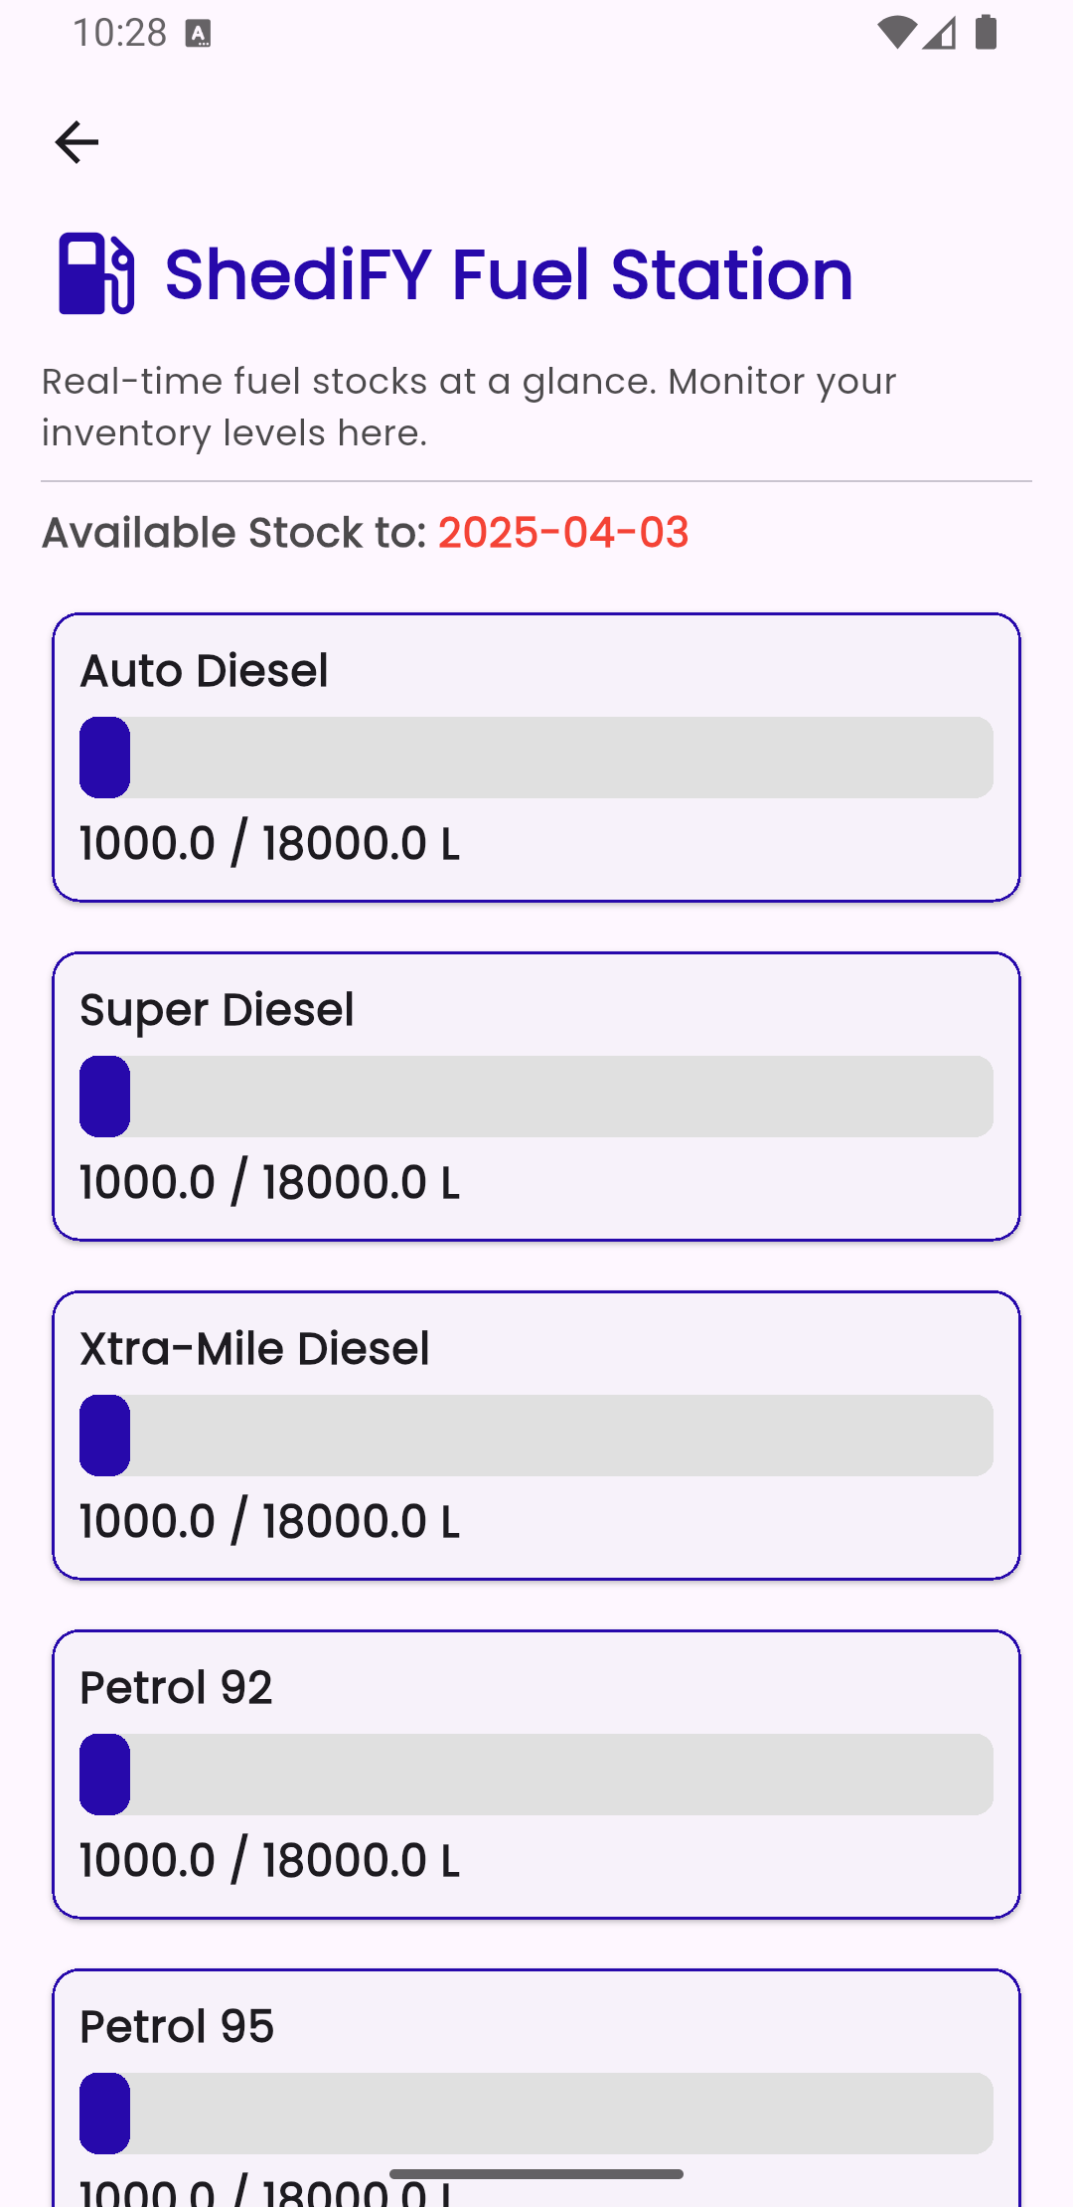

Member - 5
10953662 - Kaushalya Ratnasabapathy
Individual Contribution

Slide 14
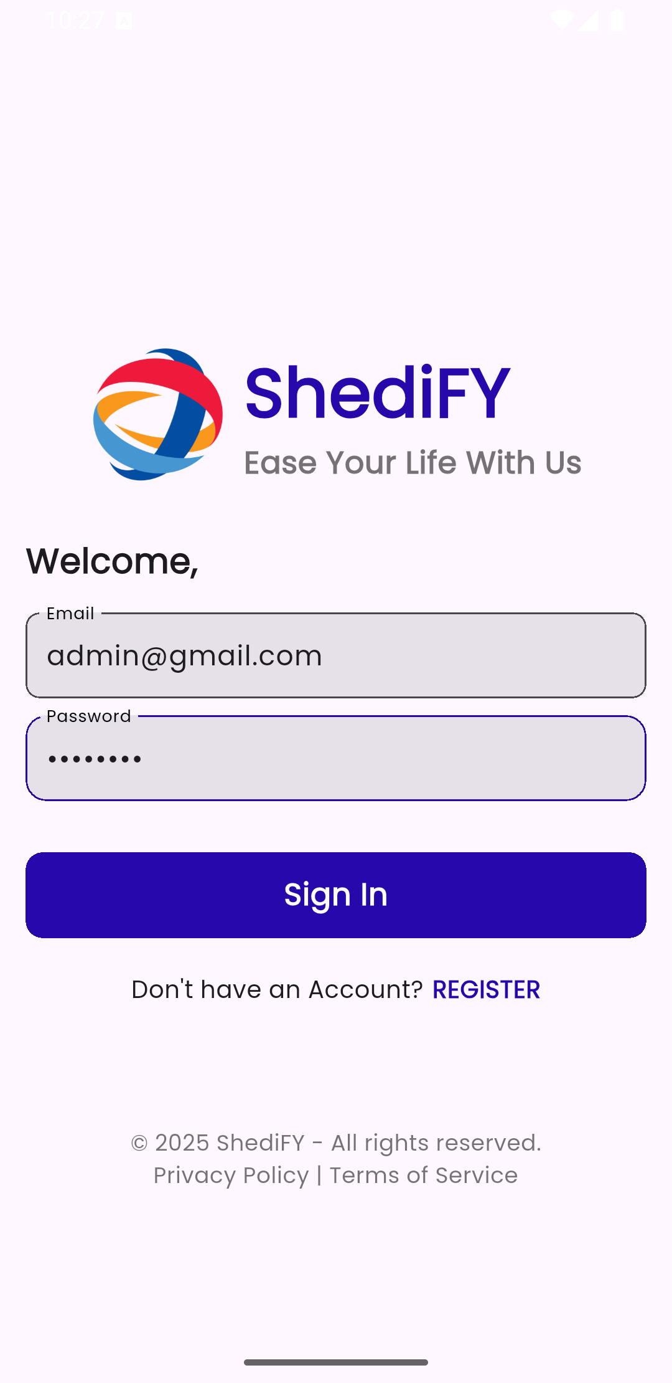
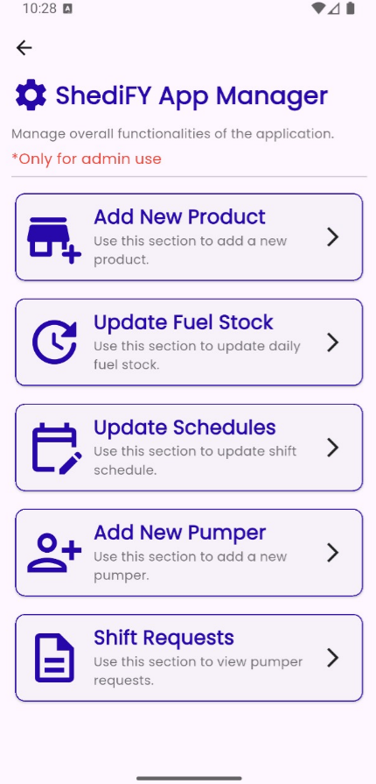

Member - 4
10953660 - Lansakara Lansakara
Individual Contribution

Slide 15
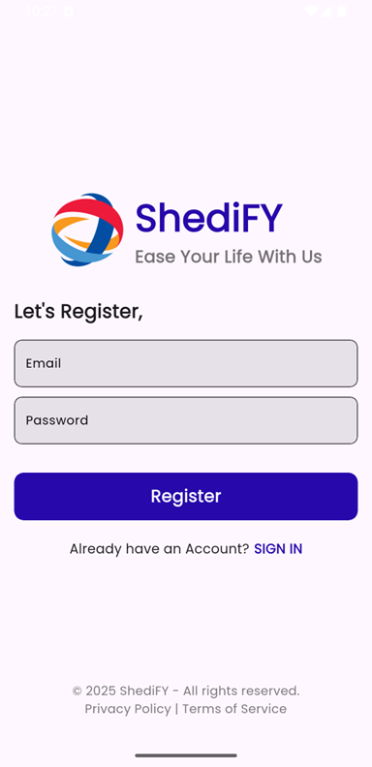
Member - 6
10953705 - Koggala Shakya
Individual Contribution

Slide 16
THE END

